Slide 2
What is Rung for Women?
Rung is a place where women can take their life and their career to the next level
We offer co-located, coordinated services – 9 organizations in one facility – to offer a one-stop shop for women to work on their personal and professional goals, plus support like childcare and grab and go meals
Cohort model, starts with transformational coaching, with each woman determining her own path to career success, financial success and meeting her own wellness goals.

Slide 3
Our Story

Slide 4
Why Rung for Women?
Women are eight times more likely to work in occupations with poverty-level wages and hold only 36% of middle-skill occupations that pay at least $35,000.
In Missouri, 38% of female-led households live in poverty.
Women have accounted for 56% of job losses during the pandemic.
In December 2020 alone, the US economy lost 140,000 jobs – all of them were women.

Slide 5
Our Program

Slide 6
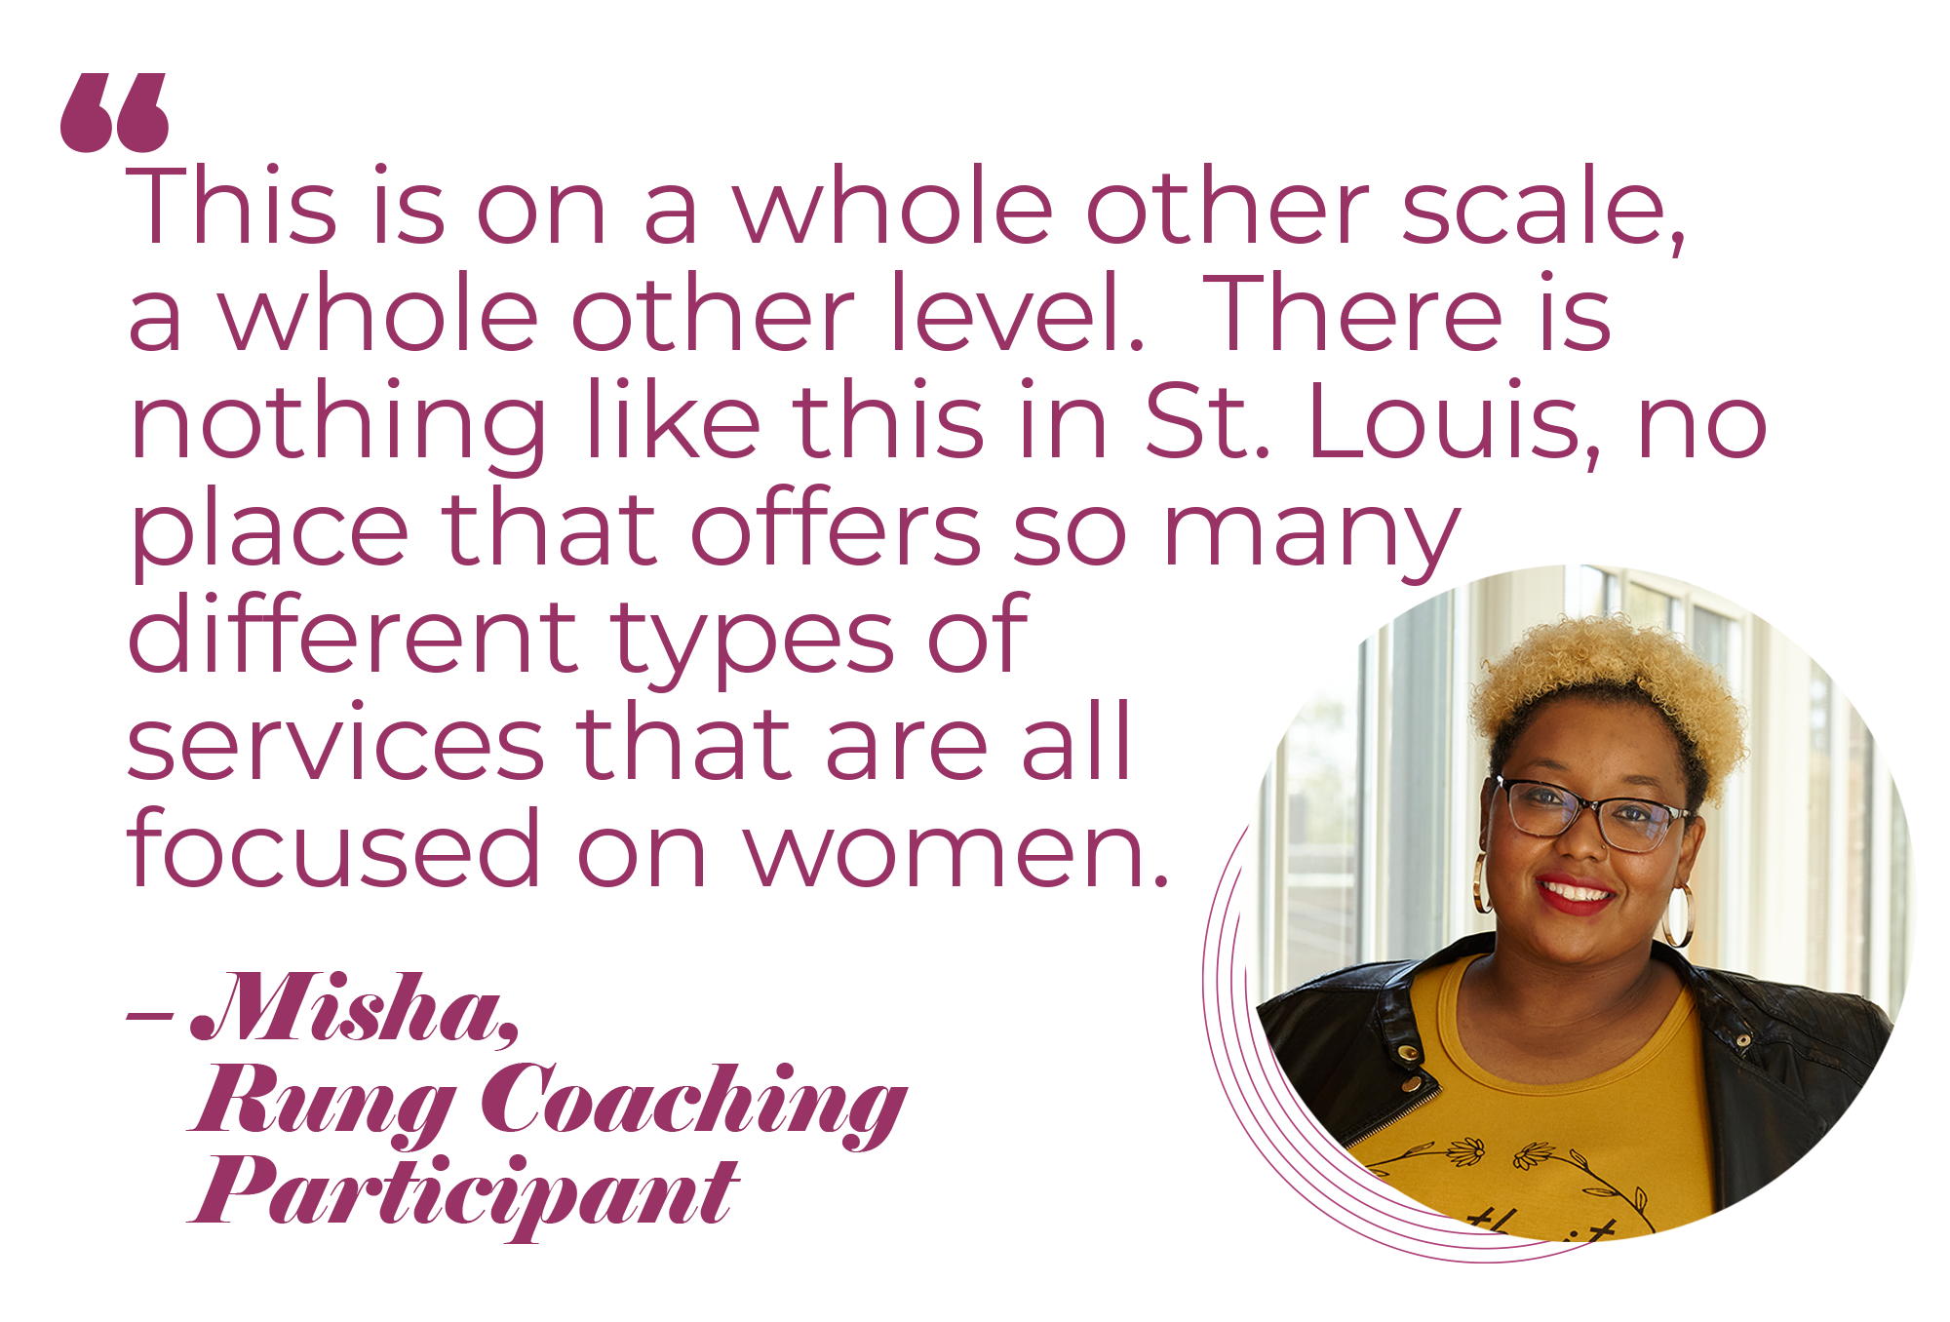
Who is a Rung woman?
21+ years of age​
Personal (not household) annual income of $50k or less​
English proficiency​
High school diploma or equivalent​
Employment history and stable housing for 6 months or longer​
Ability to access programming in person in south St. Louis City (or online as needed according to our COVID Safety Plan)

Slide 7
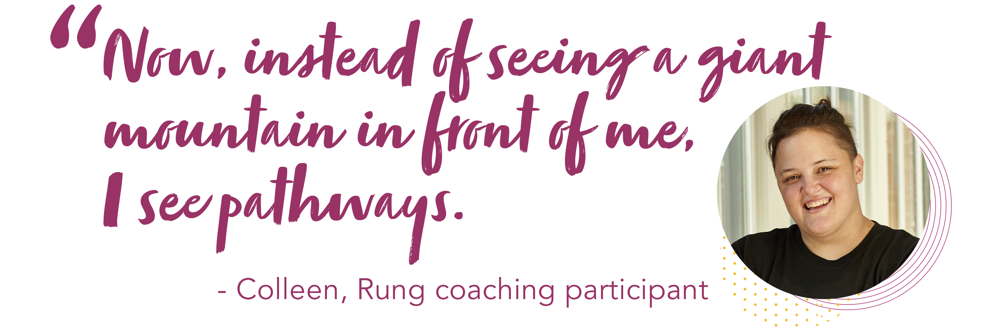
Launching in March 2021!
We will welcome our first cohort of 120 women starting in March 2021
960 applicants for 120 spots

Slide 8
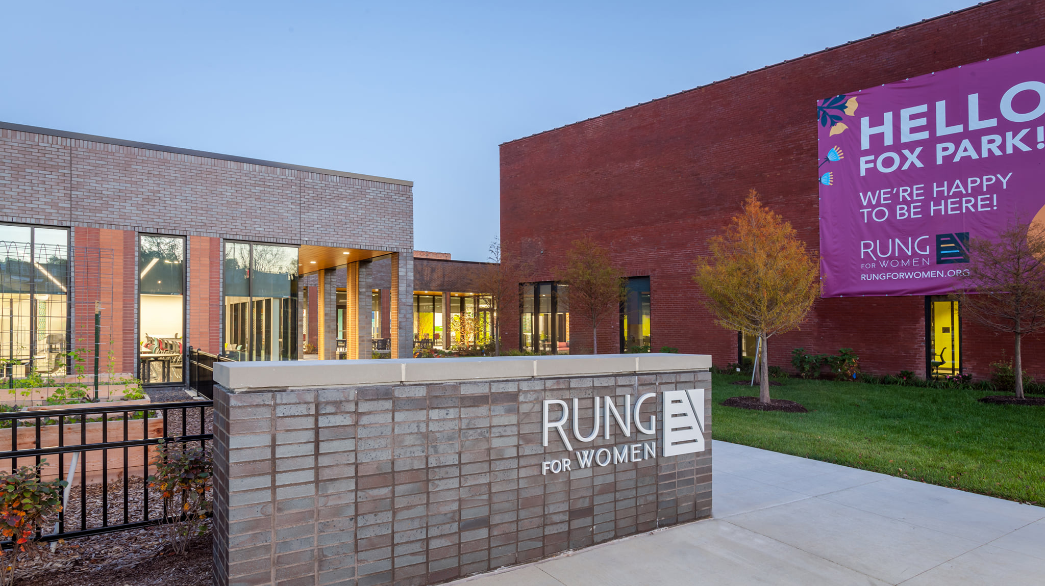

Slide 9
What is social capital?
At Rung for Women, we define social capital as: the networks of relationships among people who live and work in a particular community.
For example, as an individual you carry personal and professional social capital based on several criteria: who you know, where you are from, where you went to school, where you work, where you live, etc.

Slide 10
Why do we need social capital?
The research shows that social capital is necessary to build lasting economic impact.
According to a recent report from Ideas42 and the Kellogg Foundation titled "Poverty Interrupted" empowering people to achieve long-term economic stability requires a holistic approach: "To permanently escape poverty, families must build capital in all of these various forms … human capital (one's level of education, skills, and experiences), social capital (one's network of interpersonal connections and relationships), and health capital (one's physical and mental well- being)." (p 10)
Community-based model – Rung needs the community to support!
Programmatic components – Various levels of engagement within social capital pillar.

Slide 11
Social Capital Volunteer Opportunities
Career Exploration Circles
Affinity Groups
Speed Networking Events
Workshops
Rung Mentoring Partnership

Slide 12
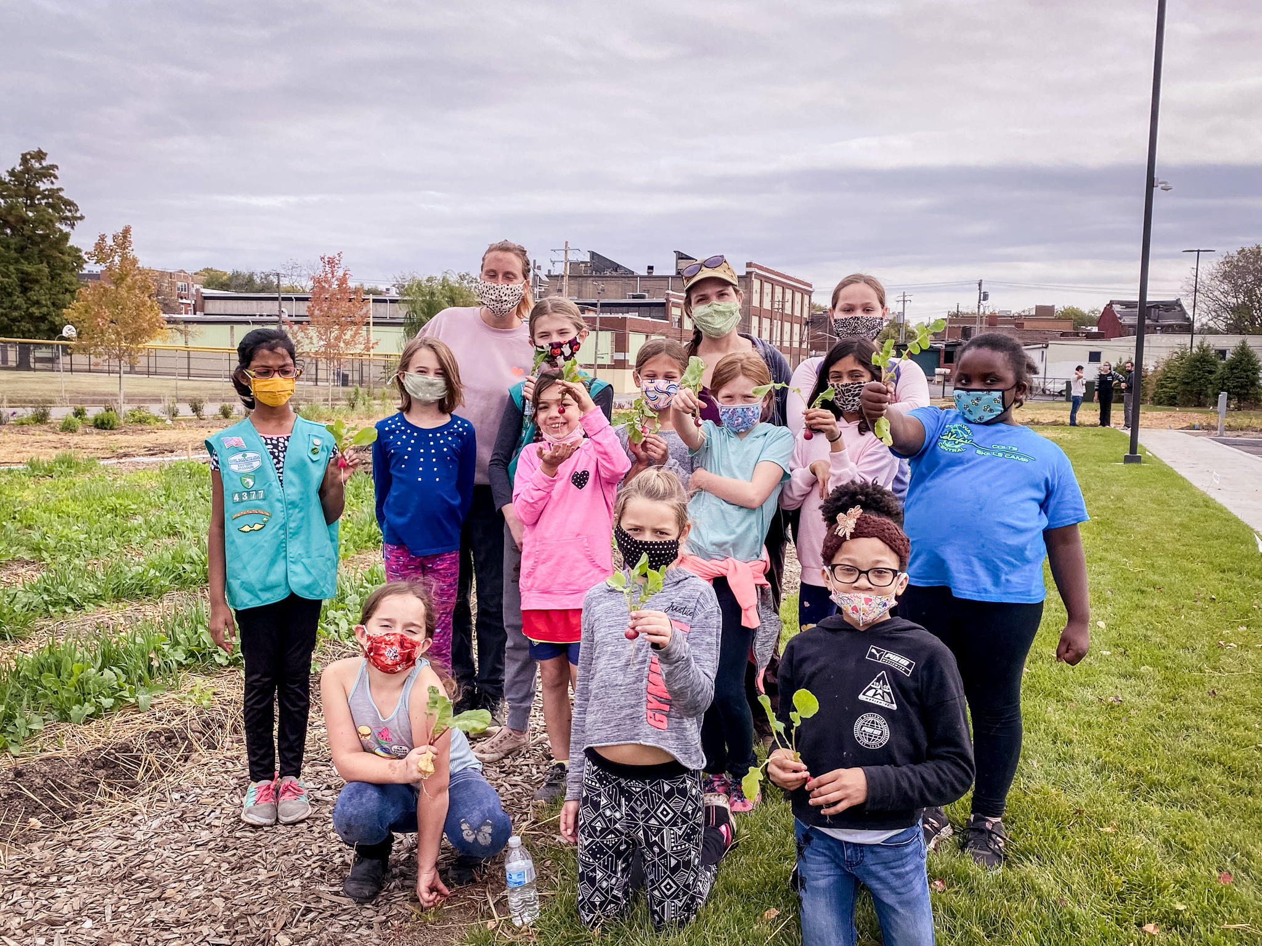
General Volunteer Opportunities
Work in garden
Pack grab & go meals
Check in members for classes
Provide tutoring services
& more!

Slide 13
Learn more & complete a volunteer interest form
Online:
www.rungforwomen/volunteer
Email:
volunteer@rungforwomen.org

Slide 14
Other ways to help
Connections to employers
Priority pathways are healthcare, technology, customer service and HR
Refer a potential member
www.rungforwomen.org/membership
Make a financial gift

